Slide 1


ANALYSIS Of H1B Visa Applications
BIG DATA – HADOOP
KEERTHI A R
S180030100191
NIIT Limited

Slide 2
TERMINOLOGIES
What is Big Data?
Big Data is a collection of large datasets that cannot be processed using traditional computing techniques. It is not a single technique or a tool, rather it involves many areas of business and technology.

Slide 3
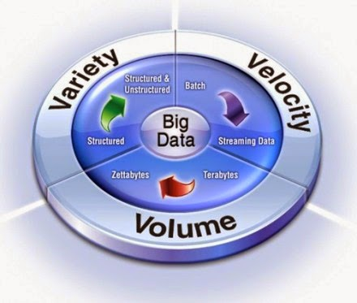
Big Data
Big data is being generated by everything around us at all times. Every digital process and social media exchange produces it. Systems, sensors and mobile devices transmit it.
3 V’s of Big Data

Slide 4
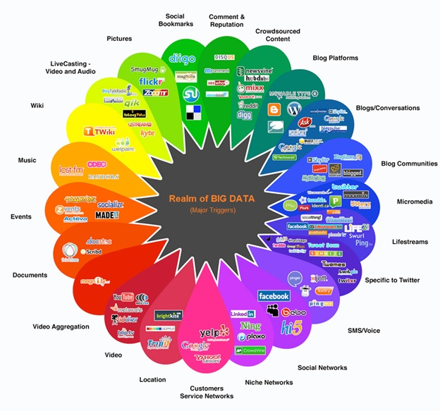
Realm of Bigdata

Slide 5
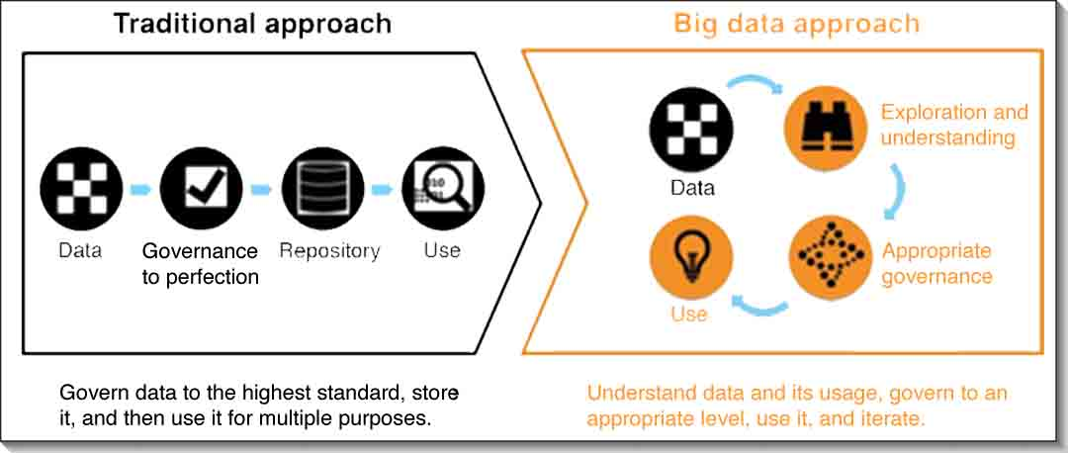
Traditional approach vs big data

Slide 6
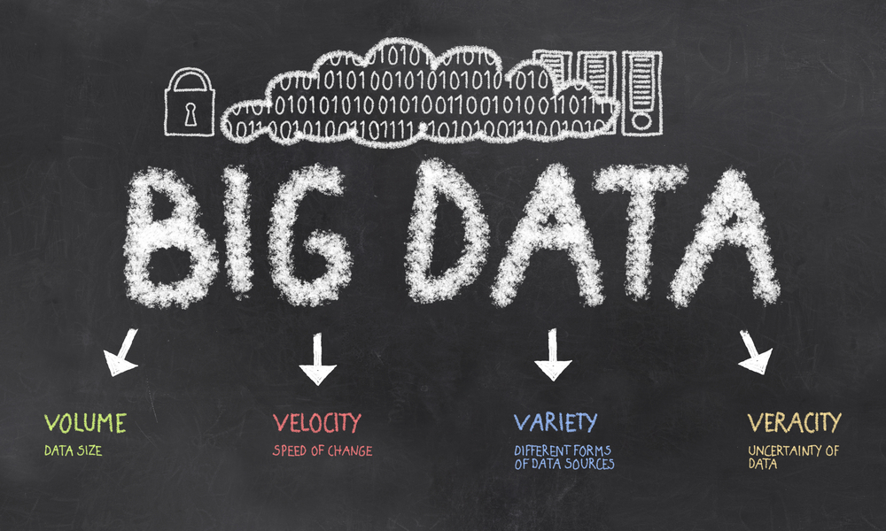
The 4 v’s of big data

Slide 7
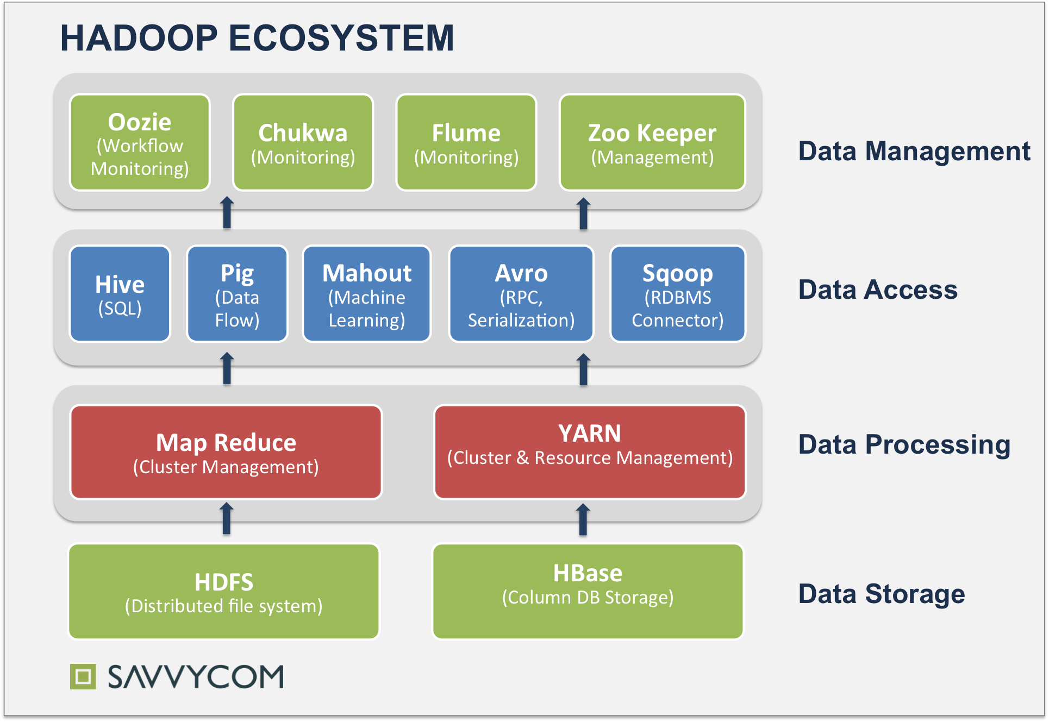
Hadoop ecosystem

Slide 8
Map Reduce
MapReduce divides a task into small parts and assigns them to many computers. Later, the results are collected at one place and integrated to form the result dataset.

Slide 9
Process in map reduce
Input Split
Map
Intermediate keys
Combiner
Shuffle and sort
Partitioner
Reducer
Output phase

Slide 10
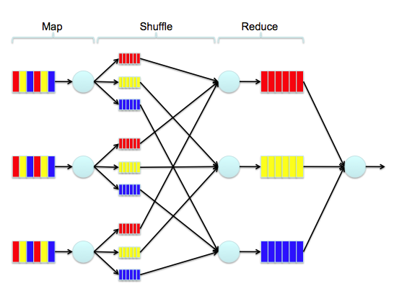
Example for Map Reduce

Slide 11
Pig latin
It is a tool/platform which is used to analyze larger sets of data representing them as data flows.
To write data analysis programs, Pig provides a high-level language known as Pig Latin.
To analyze data using Apache Pig, programmers need to write scripts using Pig Latin language. All these scripts are internally converted to Map and Reduce tasks. Apache Pig has a component known as Pig Engine that accepts the Pig Latin scripts as input and converts those scripts into MapReduce jobs.

Slide 12
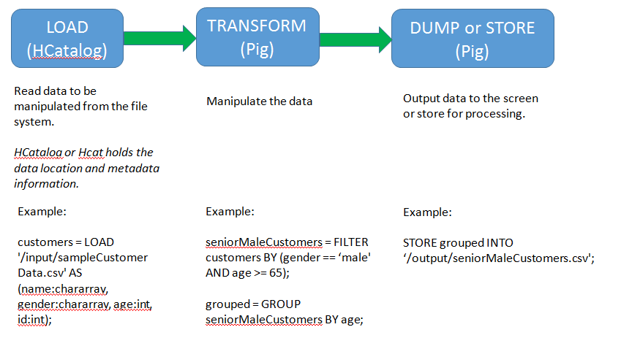
Pig dataflow

Slide 13
Hive
It is a platform used to develop SQL type scripts to do MapReduce operations.
Hive is a data warehouse infrastructure tool to process structured data in Hadoop. It resides on top of Hadoop to summarize Big Data, and makes querying and analyzing easy.
Initially Hive was developed by Facebook, later the Apache Software Foundation took it up and developed it further as an open source under the name Apache Hive. It is used by different companies. For example, Amazon uses it in Amazon Elastic MapReduce.

Slide 14
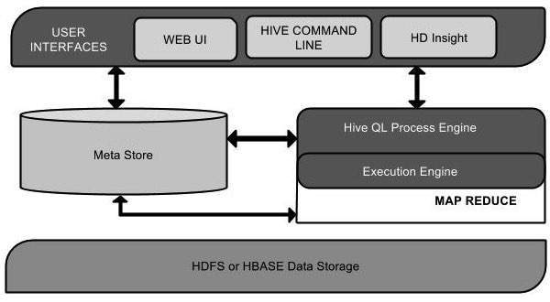
Hive architecture

Slide 15
scoop
Sqoop is a tool designed to transfer data between Hadoop and relational database servers. It is used to import data from relational databases such as MySQL, Oracle to Hadoop HDFS, and export from Hadoop file system to relational databases.

Slide 16
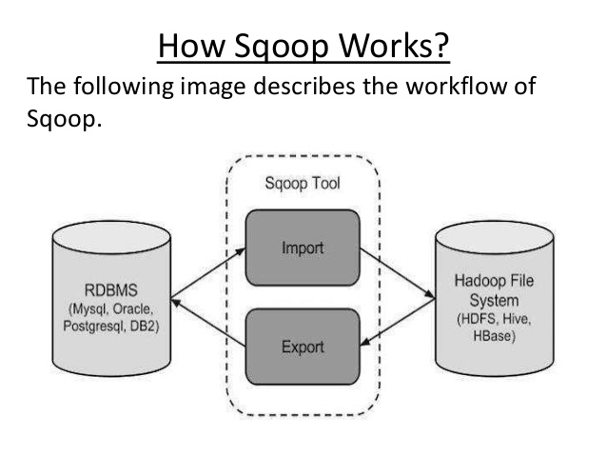

Slide 17
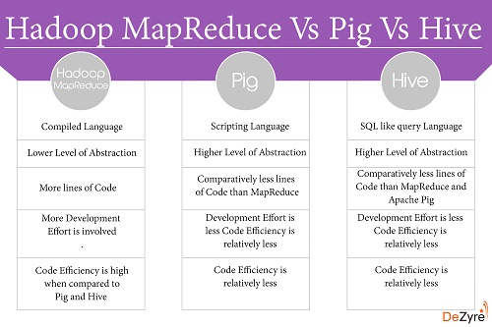

Slide 18

Project Flow
CSV
Conversion using HIVE, Pig
Data in Hive Table, CSV File
Analysis
Project Mode: Hadoop standalone mode
Tools : MapReduce, Hive, Pig, Sqoop

Slide 19


